Slide 1
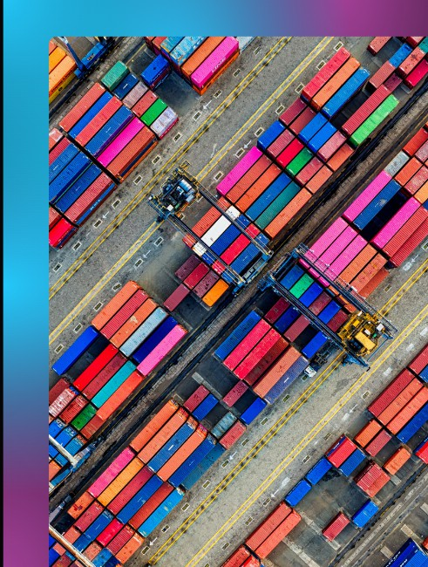
International Trade in Turkey
Latife Rabia POLAT

Slide 2
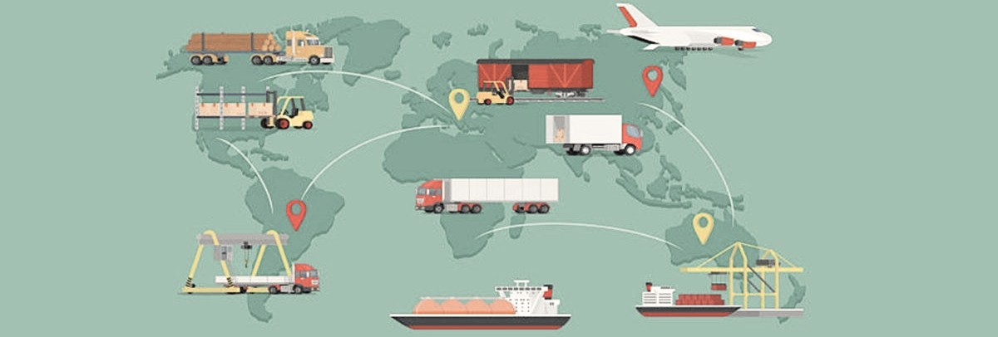
Trade VolumeandBalance
Turkey'sPosition inInternational Trade
MainTradingPartners
Turkeyhasestablishedstrong
traderelationshipswith severalcountries, including the EuropeanUnion, the UnitedStates, andthe Middle East. Thesepartnerships contributesignificantlyto Turkey'sinternationaltrade.
Turkeyhasexperienced significantgrowthinitstrade volumeovertheyears, witha focusonexports. Thecountry hasalsobeenstrivingto achieveamorebalancedtrade relationshipwithitspartners.
Turkeyisakeyplayerinthe globaltrademarket, witha strategiclocationatthe crossroadsofEurope, Asia, andtheMiddleEast.

Slide 3
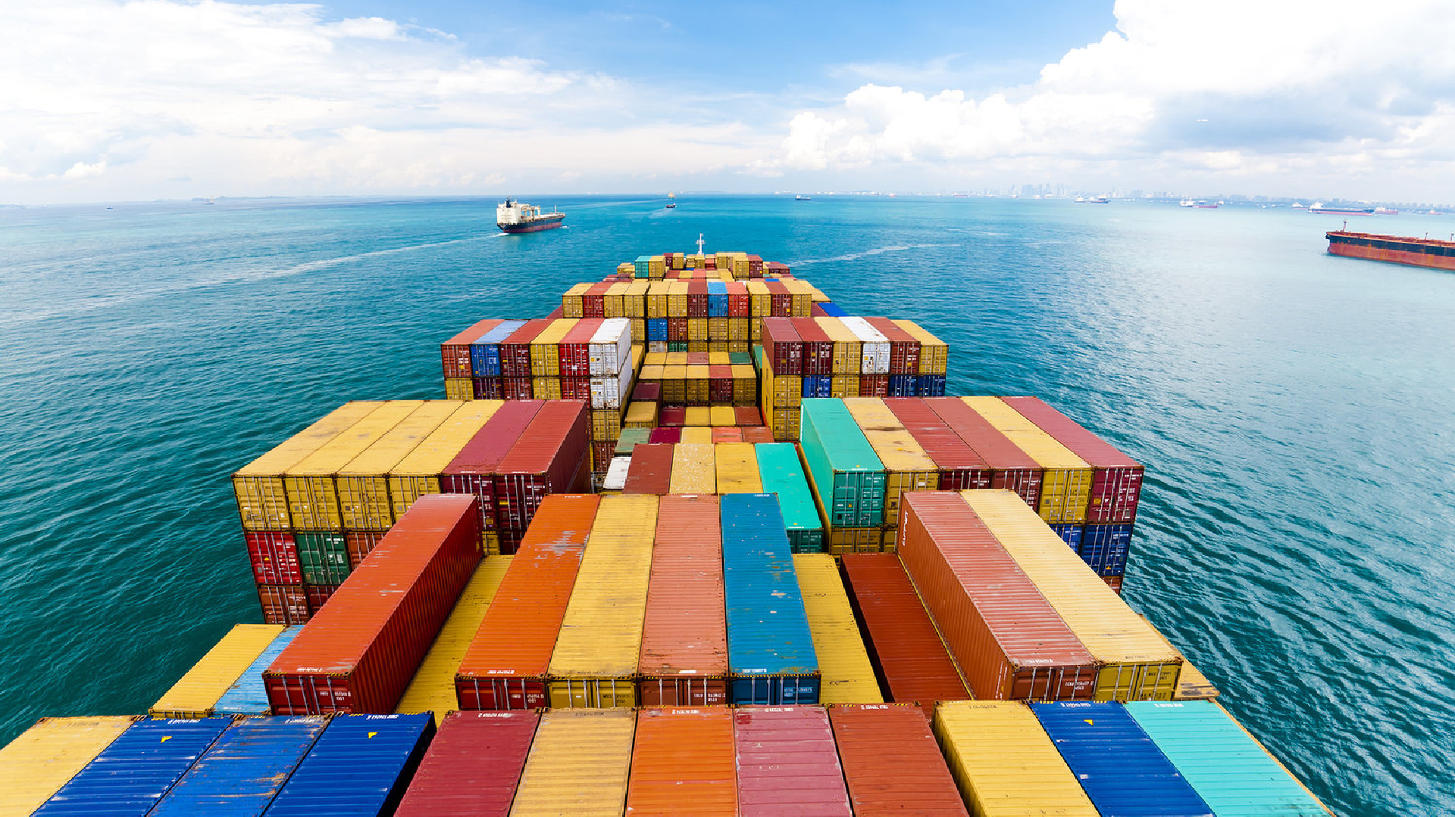
Geographical Advantage
Turkey'sstrategiclocationofferseasyaccessto majormarketsinEurope, Asia, andthe Middle East, makingitanattractivetradinghub.
Competitive Industries
Turkeyhasadiverserangeofcompetitiveindustries suchasautomotive, textiles, andelectronics, which contributetoitsinternationaltradesuccess.
InvestmentinInfrastructure
Turkeyhasinvestedheavilyinitsinfrastructure,
includingports, airports, andtransportation networks, tofacilitatetradeandattractforeign investment.
KeyFactorsDriving International TradeinTurkey

Slide 4
DiversificationofExport Markets
Digital Transformation
Thedigitaltransformationis reshapinginternationaltrade inTurkey, withincreasede- commerceactivitiesandthe adoptionofadvanced technologies.
FocusonServicesSector
Turkeyisshiftingitsfocusfrom traditionalmanufacturingtothe servicessector, includingtourism, healthcare, andfinance, todrive internationaltradegrowth.
Turkeyisexploringnewexport marketsbeyonditstraditional partners, diversifyingitstrade portfolioandreducing dependencyonspecific countries.

Slide 5
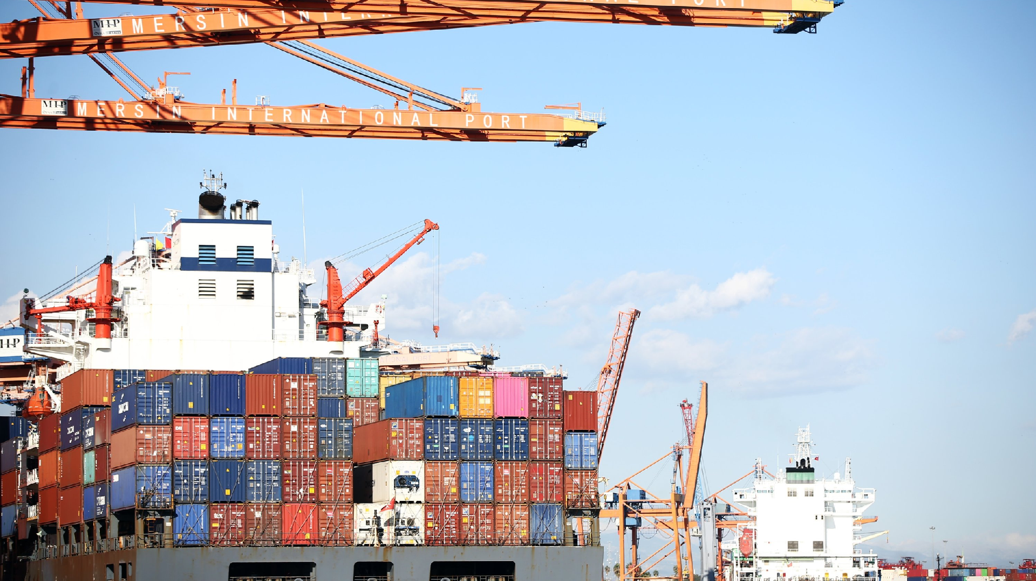
Opportunities and Challenges in International Trade in Turkey
- Accesstolargeconsumermarkets
- Growingdemandfor Turkishproductsandservices globally
- Potentialforinvestmentandcollaborationwith internationalpartners
- Geopoliticaltensionsandregionalconflicts
- Tradebarriersandprotectionistpolicies
- Volatilityinglobalmarketsandexchangerates

Slide 6
Government PoliciesandInitiativesSupportingInternational TradeinTurkey
Export Incentives
Free Trade Agreements
Infrastructure Development
Thegovernmentcontinuestoinvestin infrastructuredevelopment, including transportationnetworks, logistics centers, andcustomsprocedures, to facilitateinternationaltrade.
The Turkishgovernmentprovides variousincentives, suchastax exemptions, grants, andsubsidies, topromoteexportsandenhance thecompetitivenessofTurkish products.
The Turkishgovernmentprovides variousincentives, suchastax exemptions, grants, andsubsidies, to promoteexportsandenhancethe competitivenessofTurkishproducts.

Slide 7
Major TradingPartnersofTurkey: ACloser Look
Country
European Union United States China
Russia Russia Russia
Total Trade Volume (2020)
€170 billion
€20 billion
€22 billion
€17 billion
€17 billion
€17 billion
Main Export Products
Machinery, textiles, automotive parts Textiles, jewelry, agricultural products Machinery, electronics, textiles Energy, food products, textiles Energy, food products, textiles Energy, food products, textiles
1
2
3
4
5
6

Slide 8

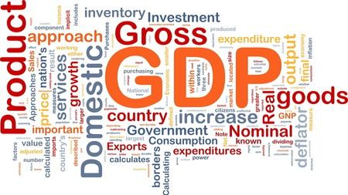

GDPGrowth
ForeignDirect Investment
Internationaltradeattracts foreigndirectinvestment, stimulatingeconomic developmentandtechnology transferinvarioussectors.
BalanceofPayments
Internationaltradeplaysa vitalroleinTurkey's economicgrowth, contributingtothecountry's GDPandemployment opportunities.
Tradeactivitiesimpact Turkey's balanceofpayments, influencing thecountry'scurrentaccount deficitorsurplus.

Slide 9
DiversificationofMarkets
Turkeyaimstodiversifyitsexportmarketsfurther, targeting emergingeconomiesandreducingrelianceonafewkeypartners.
Future Outlookfor International Tradein Turkey
Digital Transformation
Thedigitaltransformationwillcontinuetoshapeinternationaltradein Turkey, withafocusone-commerce, digitalservices, andinnovation.

Slide 10
SuccessStoriesandCase StudiesinInternational TradefromTurkey
TurkishTextile Industry
Turkey'stourismindustryhas beenamajorcontributorto internationaltrade, attracting millionsoftouristseachyear andgeneratingsubstantial revenuefortheeconomy.
TourismIndustry
The Turkishtextileindustryhas achievedsignificantsuccessin internationaltrade, becomingoneof theworld'sleadingtextileexporters throughinnovation, quality, and competitivepricing.

Slide 11
Presentedby Latife Rabia POLAT
Thankyou verymuch!

